Slide 1


Slide 2

Domain : Healthcare Team Name : Hemanth Pavithra Team Leader : Hemanth Goud Amara Team Members Member 1 : Hemanth Goud Amara Member 2 : Nomula Pavithra

Slide 3
Problem Statement : PSHC 06. create a means to easily access the medical history and records of the patient

Slide 4
CONTEXT
ABSTRACT
INTRODUCTION
SYSTEM REQUIREMENTS
SOURCE CODE
RESULT
ADVANTAGES AND DISADVANTAGES
CONCLUSION

Slide 5
ABSTRACT
Healthcare changes dramatically because of technological developments, from anesthetics and antibiotics to magnetic resonance imaging scanners and radiotherapy. Future technological innovation is going to keep transforming healthcare, yet while technologies (new drugs and treatments, new devices, new social media support for healthcare, etc) will drive innovation, human factors will remain one of the stable limitations of breakthroughs. No predictions can satisfy everybody; instead, this article explores fragments of the future to see how to think more clearly about how to get where we want to go. Significance for public healthTechnology drives healthcare more than any other force, and in the future it will continue to develop in dramatic ways. While we can glimpse and debate the details of future trends in healthcare, we need to be clear about the drivers so we can align with them and actively work to ensure the best outcomes for society as a whole.

Slide 6
INTRODUCTION
Not long ago, managing medical records was relatively straight-forward. Patient information was recorded on paper charts, which were stored in office filing cabinets.
As technology and medicine practices have rapidly changed, so have medical records and its management.
Today, more than 85% of physicians use electronic medical records (EMR) systems to manage physical records in a digital environment. With advances in diagnostics and analytical tools, there’s more patient information than ever. And, after the passing of the Health Insurance Portability and Accountability Act (HIPAA), medical providers must adhere to strict federal guidelines to protect patient privacy.
Medical professionals have a legal and ethical obligation to protect patient information and properly manage records. Failure to do so can result in medical errors and data breaches, which can lead to costly fines.

Slide 7
What is Medical Records Management?
Medical records management refers to a system of procedures and protocols responsible for governing patient information throughout the entirety of the data lifecycle. From the moment a patient record is created, it must be appropriately stored, secured, and maintained. After it has been retained for the necessary amount of time (its retention period), the record must be properly destroyed. There is a complex set of rules and regulations regarding medical records management, and for good reason. When health records are mismanaged, patients are put at risk.
Medical errors are the third leading cause of death in the United States, after heart disease and cancer, according to a study by Johns Hopkins. While studies show that patient safety improves when hospitals adopt electronic health records, poor management can lead to medication errors, missed diagnoses, treatment lapses and other potentially life threatening events.

Slide 8
Patient privacy is also at risk. Medical records contain highly sensitive personal information, and when oversights occur, privacy is compromised. With healthcare data breaches increasing, patients are losing confidence. According to a recent consumer survey, 87% of patients are unwilling to share their full medical histories, citing concerns about privacy protections.
Poor records management also leaves hospitals, medical practices and other providers vulnerable to costly fines and lawsuits, as well as criminal charges.
In 2016, healthcare benefits company Anthem agreed to pay $16 million to the U.S. Department of Health and Human Services after a series of cyberattacks exposed the health information of almost 79 million people. Government investigators discovered that Anthem didn’t take proper steps to secure patient records and was in violation of HIPAA.

Slide 9
Medical Records Policy and Procedures
Enacted in 1996, HIPAA was created to modernize medical records management and protect patients’ personal information. It outlines policies for a number of records management procedures, including the following.
Medical Records Security & Medical Records Storage
Before HIPAA, there were no standards for securing or storing patient medical records. Organizations are granted a certain amount of autonomy in creating systems that serve their sizes and needs, but HIPAA does require certain universal security measures. To maintain compliance, organizations must:
Identify and proactively protect against anticipated security threats
Train all workforce members in medical records security procedures
Limit access to facilities where records are stored or accessible
Implement hardware, software and procedures to monitor access
In 2009, Congress passed the Health Information Technology for Economic and Clinical Health (HITECH) Act. HITECH essentially strengthened HIPAA, increasing both security protocols and penalties for violations.

Slide 10
ADVANTAGES AND DISADVANTAGES :
What Are the Benefits of Electronic Health Records?
Examples of the numerous benefits of electronic medical records in hospitals and other healthcare facilities include:
Improved Quality of Care: Computerized notes are often easier to read than a physician's handwriting. This reduces the risk of errors and misinterpretations that can negatively impact the quality of patient care.
Convenience and Efficiency: Medical and office staff no longer have to waste time sorting through cumbersome paper records. Users can access electronic health records quickly and efficiently with just a few strokes on a keyboard.
Saving Space: Electronic health records eliminate the need to store documents in bulky file cabinets, which frees up more space in the office for medical supplies and equipment and other essentials.
Patient Access: Many EHR systems include a patient portal that allows patients to view their medical history and information whenever they wish.
Financial Incentives: Installing a certified EHR can help you fulfill the Meaningful Use requirements for Medicaid and Medicare, making you eligible for various incentives from the federal government.

Slide 11
What Are the Disadvantages of Electronic Health Records?
There are also several disadvantages of electronic medical records, such as:
Potential Privacy and Security Issues: As with just about every computer network these days, EHR systems are vulnerable to hacking, which means sensitive patient data could fall into the wrong hands.
Inaccurate Information: Because of the instantaneous nature of electronic health records, they must be updated immediately after each patient visit — or whenever there is a change to the information. The failure to do so could mean other healthcare providers will rely on inaccurate data when determining appropriate treatment protocols.
Frightening Patients Needlessly: Because an electronic health record system enables patients to access their medical data, it can create a situation where they misinterpret a file entry. This can cause undue alarm, or even panic.
Malpractice Liability Concerns: There are several potential liability issues associated with EHR implementation. For example, medical data could get lost or destroyed during the transition from a paper-based to a computerized EHR system, which could lead to treatment errors. Since doctors have greater access to medical data via EHR, they can be held responsible if they do not access all the information at their disposal.

Slide 12
SOURCE CODE
MY SQL CODE :
create database joker;
use joker;
create table hospital(sno varchar(6),name varchar(10),age varchar(3),phone varchar(14),gender varchar(8),dob varchar(20),address varchar(20),height varchar(2),weight varchar(2),pid varchar(10),disease varchar(20),admit_date varchar(15),discharge_date varchar(20),guardian_name varchar(20));
insert into hospital values('1','mittu','55','7569642310','male','20-nov-1998','india','5','41','6281314216','dengue','27-aug-2008','09-sept-2008','hari’);
insert into hospital values('2','akshay','21','7569642318','female','20-nov-2002','hyderabad','6','49','6281314211','typhoid','29-aug-2008','19-sept-2008','navya’);
insert into hospital values('3','vamsi','44','7569642313','male','20-dec-1998','telangana','7','51','6281317216','cancer','26-aug-2002','09-sept-2002','satya’);
select *from hospital;

Slide 13
PYTHON SOURCE CODE :
from tkinter import *
import mysql.connector
def Ok():
global myresult
pid= e1.get()
sno= e2.get()
name = e3.get()
age=e4.get()
phone=e5.get()
gender=e6.get()
dob=e7.get()
address=e8.get()
height=e9.get()
weight=e10.get()
disease=e11.get()
admit_date=e12.get()
discharge_date=e13.get()
guardian_name=e14.get()

Slide 14
mysqldb=mysql.connector.connect(host="localhost",user="root",password="pavithra",database="joker")
mycursor=mysqldb.cursor()
try:
mycursor.execute("SELECT * FROM hospital where pid = '" + name + "'")
myresult = mycursor.fetchall()
for x in myresult:
print('x')
e2.delete(0, END)
e2.insert(END, x[1])
e3.delete(0, END)
e3.insert(END, x[2])
e4.delete(0,END)
e4.insert(END,x[3])
e5.delete(0,END)
e5.insert(END,x[4])
e6.delete(0,END)
e6.insert(END,x[5])
e7.delete(0,END)

Slide 15
e7.insert(END,x[6])
e8.delete(0,END)
e8.insert(END,x[7])
e9.delete(0,END)
e9.insert(END,x[8])
e10.delete(0,END)
e10.insert(END,x[9])
e11.delete(0,END)
e11.insert(END,x[10])
e12.delete(0,END)
e12.insert(END,x[11])
e13.delete(0,END)
e13.insert(END,x[12])
e14.delete(0,END)
e14.insert(END,x[13])
except Exception as e:
print(e)
mysqldb.rollback()
mysqldb.close()

Slide 16
root = Tk()
root.title("HOSPITAL RECORDS")
root.geometry("1400x1400")
Label(root, text="Patient ID").place(x=10, y=10)
Button(root, text="Search", command=Ok ,height = 1, width = 13).place(x=580, y=40)
Label(root, text="Sno").place(x=10, y=80)
Label(root, text="Name").place(x=10, y=120)
Label(root, text="Age").place(x=10, y=160)
Label(root, text="phone").place(x=10, y=200)
Label(root, text="gen]der").place(x=10, y=240)
Label(root, text="DOB").place(x=10, y=280)
Label(root, text="Address").place(x=10, y=320)
Label(root, text="Height").place(x=10, y=360)
Label(root, text="Weight").place(x=10, y=400)
Label(root, text="Disease").place(x=10, y=440)
Label(root, text="Admit Date").place(x=10, y=480)
Label(root, text="Discharge Date").place(x=10, y=520)
Label(root, text="Guardian name").place(x=10, y=560)

Slide 17
e1 = Entry(root)
e1.place(x=580, y=10)
e2 = Entry(root)
e2.place(x=580, y=80)
e3 = Entry(root)
e3.place(x=580, y=120)
e4 = Entry(root)
e4.place(x=580, y=160)
e5 = Entry(root)
e5.place(x=580, y=200)
e6 = Entry(root)
e6.place(x=580, y=240)
e7 = Entry(root)
e7.place(x=580, y=280)

Slide 18
e8.place(x=580, y=320)
e9 = Entry(root)
e9.place(x=580, y=360)
e10 = Entry(root)
e10.place(x=580, y=400)
e11 = Entry(root)
e11.place(x=580, y=440)
e12 = Entry(root)
e12.place(x=580, y=480)
e13 = Entry(root)
e13.place(x=580, y=520)
e14 = Entry(root)
e14.place(x=580, y=560)
root.mainloop()

Slide 19
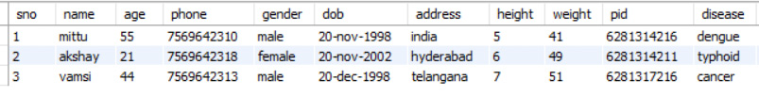

RESULT :
MY SQL :

Slide 20
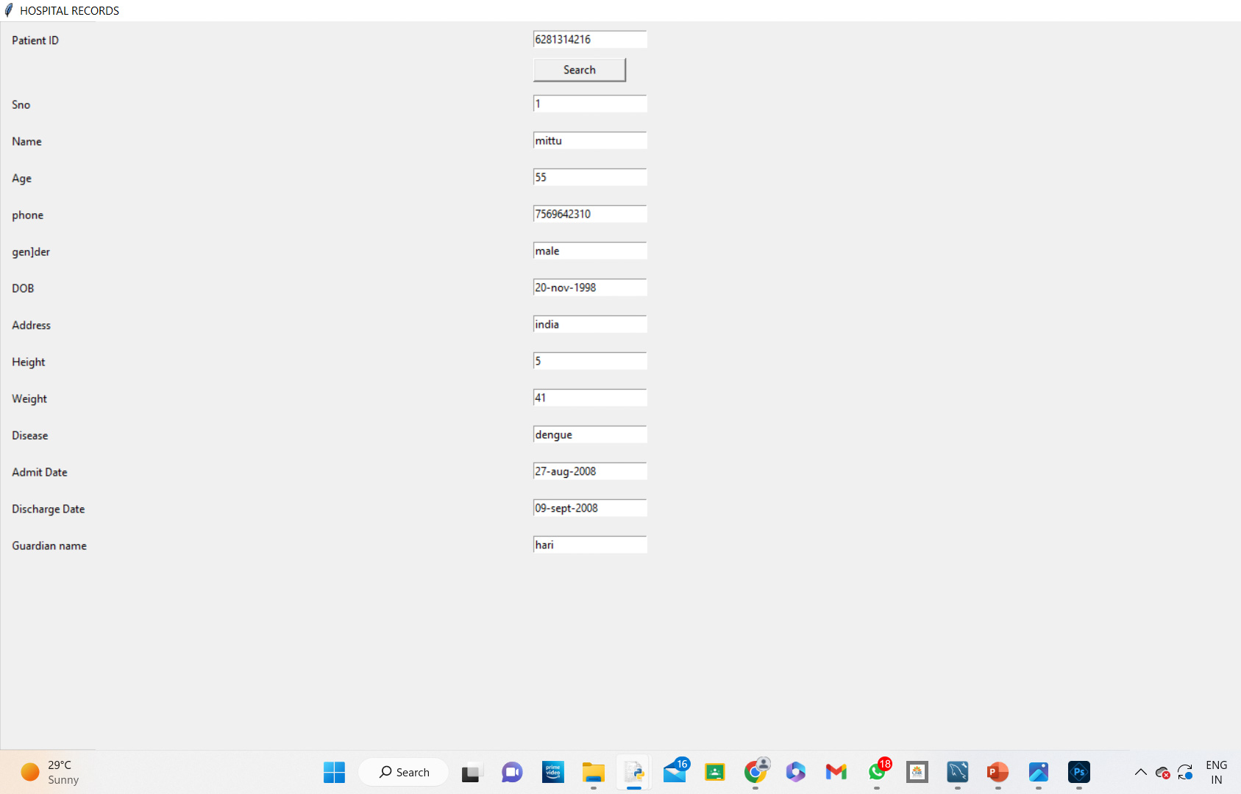
PYTHON :

Slide 21
CONCLUSION
Patient records are the primary repository of data in the information-intensive health care industry. Although clinical information is increasingly likely to be computerized, the current, predominant mode for recording patient care data remains the paper record. Paper records have the advantages of being familiar to users and portable; when they are not too large, users can readily browse through them. Paper records, however, have serious, overriding limitations that frequently frustrate users and perpetuate inefficiencies in the health care system. Further, the impact of these limitations is growing as the health care system becomes more complex. Modern patient care requirements have outgrown the paper record.

Slide 22
REFERENCES
Source code:
https://code-projects.org/record-manager-in-python-with-source-code/
Information :
https://nap.nationalacademies.org/read/5306/chapter/9#178
https://www.accesscorp.com/blog/medical-records-management-overview/

Slide 23
THANK YOU

